Slide 1
Sampling I
Wenchao Ma
University of Minnesota

Slide 2
Outline
Key sampling vocabulary
Probability Sampling

Slide 3
Key Sampling Vocabulary

Slide 4
Target Population
The target population is the group of units to which survey results will be generalized.
It includes not just individuals, but entities like households, schools, hospitals, businesses, and more.
The goal is to ensure that the survey results apply to this broader population.

Slide 5
Element
Each member of the population
Note:
Not all elements are sampled!

Slide 6
List Sample
List of the individual elements in the entire population
Not always available ☺

Slide 7
Sampling Frame
A list, map, or other specification of elements in the population from which a sample may be selected.
Examples include a list of all university students, a telephone directory, or a map of geographic areas.
Notes:
Once the population has been defined - in particular, the target and the survey population - the next step is to establish a means of access to it. The frame will provide this means of access. In its simplest form the frame is a list of elements covering the survey population
A list, map, or other specication of units in the population from which a sample may be selected. Examples include a list of all university students, a telephone directory, or a map of geographic areas.

Slide 8
Sampling unit
For the purpose of sample selection, the population should be divisible into a finite number of distinct, nonoverlapping and identifiable units called sampling units, so that each member of the population belongs to only one sampling unit.
A sampling unit refers to an element or a set of elements about which information is measured.

Slide 9
Observation/Case/Subject
Each selected element for which data were gathered successfully

Slide 10
Coverage
Proportion of the target population that can be selected & surveyed
Often expressed as a percentage (%)

Slide 11
Defects in Coverage
Called non-coverage/under coverage
Arise because we usually can’t survey every element of our target population
Practical limitations (time, cost)
Information about the population (we can’t survey people we don’t know about or can’t reach)

Slide 12
Problems arising from Undercoverage
Undercoverage is usually not random
Often systematically related to participant characteristics
Consequence: Sample may not accurately represent all subgroups within the population

Slide 13
Probability Samples
Each element in the population has a known probability of being selected
Types of probability samples
Simple random sample
Stratified sample
Cluster sample
Systematic sample
Notes:
single probability sample is not guaranteed to mirror the popul ation with regard to the characteristics of interest, but we can quantify what propor tion of the possible samples will give a statistic that is within a xed degree of tolerance from the popul ation quantity.

Slide 14
Most results in sampling rely on the sampling distribution

Slide 15
An example
We are interested in the average number of hours UofM undergraduates spend studying during the study week
What are the population and parameter?
A random sample of 10 UofM undergraduates:
10, 5, 13, 10, 20, 22, 12, 8, 4, 16
What are the sample and statistic?

Slide 16
An example
Population: all UofM undergraduates
Parameter (μ): the average number of hours spend studying during finals week
Sample:10 UofM undergraduates
Statistic (M): 12
Conclusion: The estimated average number of hours all UofM undergraduates spend studying during finals week is 12.

Slide 17
An example
How accurate is the estimate?
How do we assess the accuracy of our estimate?

Slide 18
Sampling Variability
What would happen if we took many samples of same size?
UofM graduates
Sample
Sample
Sample
Sample
μ
Sample
Sample
Sample
Sample

Slide 19
Sampling Distributions
If we took every one of the possible samples of a certain size, calculated the sample mean for each, and graphed all of those values, we’d have a sampling distribution of the sample mean.
The population distribution of a variable is the distribution of values of the variable among all individuals in the population.
The sampling distribution of a statistic is the distribution of values taken by the statistic in all possible samples of the same size from the same population.

Slide 20
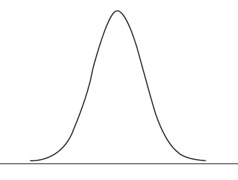
UofM graduates
Sample
Sample
Sample
Sample
Sample
Sample
Sample
Sample
Calculate average number of hours for each sample
Sample means

Slide 21


The standard deviation of a sampling distribution is called the standard error
Standard Error
The extent to which sample means selected from the same population differ from one another
How accurate the sample mean is
SE=$\frac{σ}{\sqrt{n}}$
N$\left(μ,\frac{σ}{\sqrt{n}}\right)$
Sample means

Slide 22
Factors That Decrease Standard Error
We want to have an accurate sample mean (smaller standard error).
What can we do to achieve this goal?

Slide 23
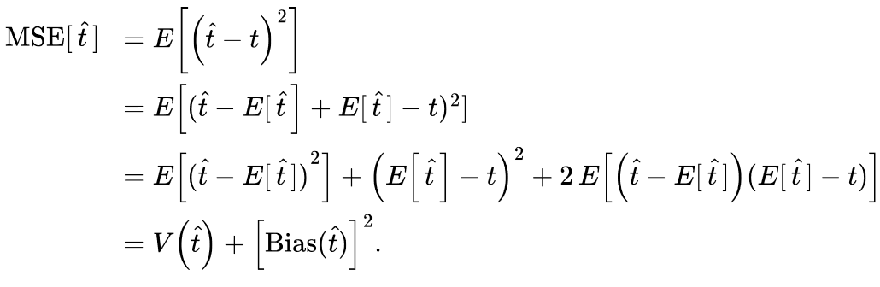

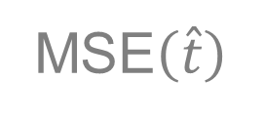
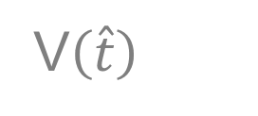
Because we sometimes use biased estimators, we often use the mean squared error (MSE) rather than variance to measure the accuracy of an estimator:
An estimate is unbiased if , precise if
is small, and accurate if is small.
$$E\left(\hat{t}\right)=t$$
V$\left(\hat{t}\right)$
MSE$\left(\hat{t}\right)$

Slide 24

Simple Random Samples
Uses random selection
Each element has the same probability of being included
Notes:
Image from https://www.questionpro.com/blog/probability-sampling/

Slide 25
Simple Random Samples
To take an SRS, you need a list of all observation units in the population; this list is the sampling frame.
In an SRS, the sampling unit and observation unit coincide.

Slide 26
Simple Random Samples
Whether one element is selected has no effect on whether any other element is selected
Selections are independent
Usually conducted without replacement
After an element is selected it can’t be selected again

Slide 27


Simple Random Samples
Estimating a population mean
$$\hat{y}=\overline{y}$$
Estimating population variance

Slide 28

Simple Random Samples
Variance of the sample mean is
Factor (1 − n/N) is called the finite population correction (fpc).

Slide 29


Sampling weight
Sampling weight of sampled unit i can be interpreted as the number of population units represented by unit i.
Sometimes called the design weight
The inclusion probability in SRS is
The sampling weight sampled unit i is the reciprocal of inclusion probability
$$π_{i}=\frac{n}{N}$$
$$w_{i}=\frac{1}{π_{i}}$$

Slide 30
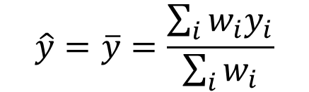

Sampling weight
The population size is estimated by the sum of the weights for the sample:
the population mean is estimated by
$$N=\sum_{i}{w_{i}}$$
$$\hat{y}=\overline{y}=\frac{\sum_{i}{w_{i}y_{i}}}{\sum_{i}{w_{i}}}$$

Slide 31

Sampling distribution under SRS
Many times, we are not only interested in estimating population mean
We also report the accuracy of the estimation
The standard error (SE) is the square root of the estimated variance of sample mean

Slide 32
Sampling distribution under SRS
In addition to point estimation, we might be also interested in interval estimation
We can report confidence interval
Notes:
When you take a sample survey, it is not suf cient to simply report the average height of trees or the sample proportion of voters who intend to vote for Candidate B in the next election. You also need to give an indication of how accurate your estimates are. Con dence intervals (CIs) indicate the accuracy of an estimate. A 95% con dence interval is often explained he

Slide 33
UofM graduates
Sample
Sample
Sample
Sample
Sample
Sample
Sample
Sample
Calculate average number of hours for each sample
Q: What are the mean and variance of the sampling distribution?
Sample means

Slide 34

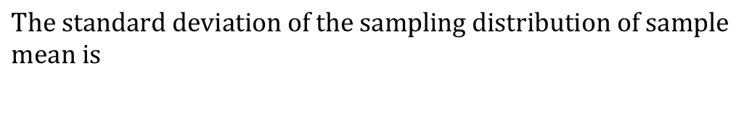
The Sampling Distribution of a Sample Mean
The Sampling Distribution of Sample Means
$$\text{The} mean \text{of} \text{the} \text{sampling} \text{distribution} \text{of} \text{sample} \text{mean} \text{is} equal to the population mean$$
$$\text{The} standard deviation \text{of} \text{the} \text{sampling} \text{distribution} \text{of} \text{sample} \text{mean} \text{is}$$
$$SE\left(\overline{y}\right)=\sqrt{(1−\frac{n}{N})\frac{s^{2}}{n}}$$
34

Slide 35
UofM graduates
Sample
Sample
Sample
Sample
Sample
Sample
Sample
Sample
Calculate average number of hours for each sample
Q: What are the shape of the sampling distribution?
Sample means

Slide 36
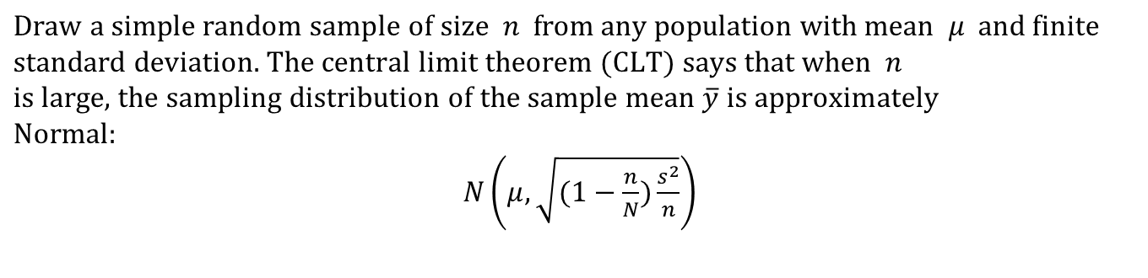
As the sample size increases, the distribution of sample means begins to look more and more like a Normal distribution!
When the sample is large enough, the distribution of sample means is very close to Normal, no matter what shape the population distribution has, as long as the population has a finite standard deviation.
$$\text{Draw} \text{a} \text{simple} \text{random} \text{sample} \text{of} \text{size} n \text{from} \text{any} \text{population} \text{with} \text{mean} μ \text{and} \text{finite} \\ \text{standard} \text{deviation}\text{. }\text{The} central limit theorem (CLT) \text{says} \text{that} \text{when} n \\ \text{is} \text{large}\text{, }\text{the} \text{sampling} \text{distribution} \text{of} \text{the} \text{sample} \text{mean} \overline{y} \text{is} \text{approximately} \\ \text{Normal}\text{:}$$ $N\left(μ,\sqrt{(1−\frac{n}{N})\frac{s^{2}}{n}}\right)$

Slide 37
An illustration
http://onlinestatbook.com/stat_sim/sampling_dist/

Slide 38
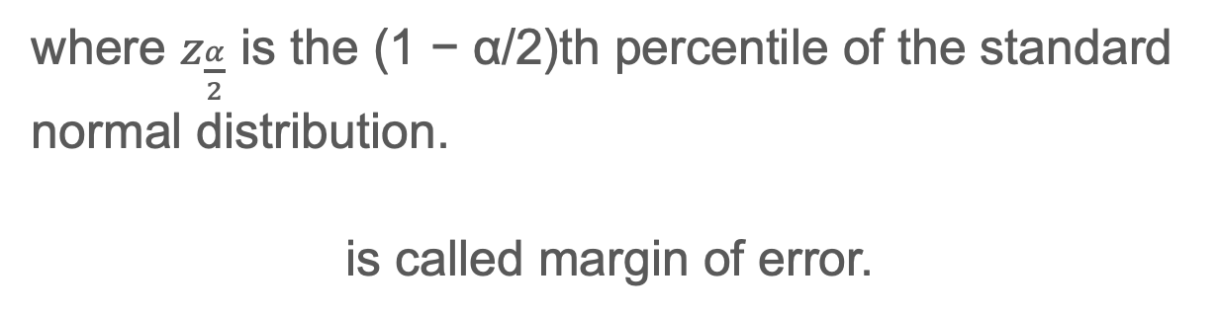
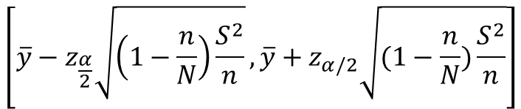

Confidence Intervals
large-sample 100(1 − α) % CI for the population mean can be calculated as
$$\left[\overline{y}−z_{\frac{α}{2}}\sqrt{\left(1−\frac{n}{N}\right)\frac{S^{2}}{n}},\overline{y}+z_{α/2}\sqrt{(1−\frac{n}{N})\frac{S^{2}}{n}}\right]$$
where $z_{\frac{α}{2}}$ is the (1 − α/2)th percentile of the standard normal distribution.
is called margin of error.
$$z_{\frac{α}{2}}\sqrt{\left(1−\frac{n}{N}\right)\frac{S^{2}}{n}}$$

Slide 39
Example
In a Pew Research Center political survey conducted in 2023, 1,500 U.S. adults were polled about their approval of the president’s job performance. The survey reported that 52% of respondents approved of the president's performance, with a margin of error of 3 percentage points at the 95% confidence level.
This means the true approval rating for the president in the general population could range from _____ to _______.

Slide 40


Determining sample size
Specify the tolerable error
e is the margin of error.
Again, the margin of error is one-half of the width of a CI.
$${e=z}_{α/2}\sqrt{(1−\frac{n}{N})\frac{S^{2}}{n}}$$
Notes:
Anyone designing an SRS must decide what amount of sampling error in the estimates is tolerable and must balance the precision of the estimates with the cost of the survey. Even though many variables may be measured, an investigator can often focus on one or two responses that are of primary interest in the survey, and use these for estimating a sample size.

Slide 41


Determining sample size
When N is very large, we can ignore the fpc term and thus
If we cannot ignore fpc, the sample size is
$$n={\left(\frac{{S×z}_{α/2}}{e}\right)}^{2}$$
$$n_{fpc}=\frac{n}{1+\frac{n−1}{N}}$$
Notes:
Anyone designing an SRS must decide what amount of sampling error in the estimates is tolerable and must balance the precision of the estimates with the cost of the survey. Even though many variables may be measured, an investigator can often focus on one or two responses that are of primary interest in the survey, and use these for estimating a sample size.

Slide 42
Determining sample size
For many surveys of people in which a proportion is measured, the margin of error is set at e = 0.03 and α = 0.05 (Lohr, 2022)
When interested in a proportion, we can use 1/4 as an upper bound for S².
For other quantities, S² must be estimated or guessed at.
Notes:
Anyone designing an SRS must decide what amount of sampling error in the estimates is tolerable and must balance the precision of the estimates with the cost of the survey. Even though many variables may be measured, an investigator can often focus on one or two responses that are of primary interest in the survey, and use these for estimating a sample size.

Slide 43
Simple Random Samples
Major benefit of simple random samples:
Elements are selected with the same probability
No weighting required to represent the target population

Slide 44
Exercise I
Suppose we want to conduct a survey to estimate the proportion of current U of M students who support the use of AI, like ChatGPT, for classroom learning. We plan to take an SRS and want to use a 95% CI with margin of error 0.03.
Let’s first ignore the fpc, the sample size required is _____.
If we assume U of M has 50,000 students, the sample size required is _____.

Slide 45
Exercise II
A data set with 2044 observations on 5 variables.
Hrsrelax: After an average work day, about how many hours do you have to relax or pursue activities that you enjoy
Mntlhlth: For how many days during the past 30 days was your mental health, which includes stress, depression, and problems with emotions, not good?
Hrs1: Hours worked each week.
Degree: Educational attainment or degree.
Grass: Do you think the use of marijuana should be made legal, or not?

Slide 46
Exercise II
Open gss2010.xlsx file on Canvas using Excel
Assume the 2044 cases are all units in the sampling frame
Estimate the proportion of individuals who think the use of marijuana should be made legal with an SRS of size 10, 50 and 100

Slide 47
Exercise II
Now calculate the sample size required to achieve a margin of error 0.03 for 95% CI and draw a sample accordingly
What is the sampling weight of each individual in the sample?
What is the inclusion probability of each individual in the sampling frame?
Calculate the proportion based on the sample.
Construct a 95% CI

Slide 48

Stratified Random Samples
Target population is divided into strata (groups)
Groups that don’t overlap, but together they represent the target population
Simple Random Samples are drawn from each strata separately
Notes:
divide the popul ation into Hsubpopulations, called strata. The strata do not overlap, and they constitute the whole popul ation so that each sampling unit belongs to exactly one stratum. We draw an independent probability sample from each stratum, then pool the information to obtain overall population estimates.

Slide 49
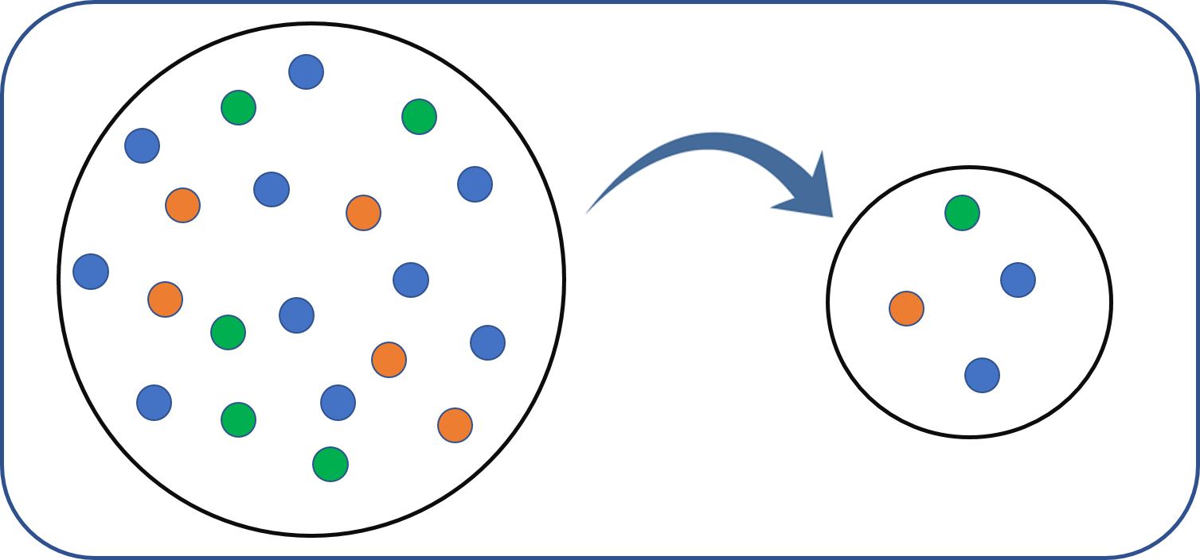

Slide 50
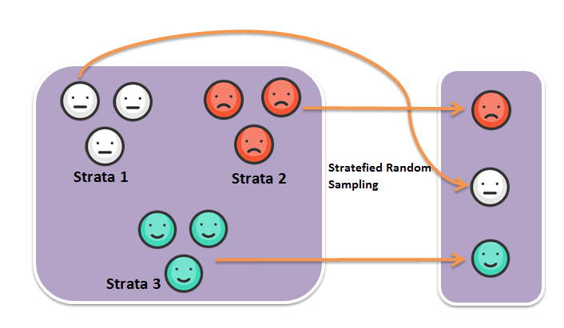

Slide 51
An example
The University Health Center is considering the adoption of a new program to help young adults lose weight. Before changing programs, the administration commissioned a survey to find out, among other things, how their new program compared with the current one and how male and female students of different ages performed.
Previous experience had suggested that older students appeared to do better in weight reduction programs. Therefore, the surveyors planned to get a sample of men and women in two age groups—17 to 22 years and 23 to 28 years—and compare their performance in each of the programs.

Slide 52
An example
About 310 undergraduates signed up for the health center’s regular weight reduction program for the winter seminar.
Of the 310 participants, 140 were between 17 and 22 years old, and 62 of these were men. Also 170 students were between 23 and 28 years, and 80 of these were men.
The surveyors randomly selected 40 persons from each of the four subgroups (male, female, ages 17–22, and ages 23–28) and randomly assigned every other student to the new program. The sample looked like this:

Slide 53
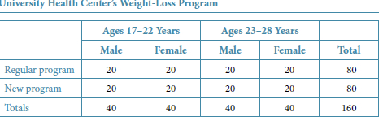
An example
Fink, A. (2015). How to conduct surveys: A step-by-step guide. SAGE publications.

Slide 54
Why Stratified Random Samples?
We want to be protected from the possibility of obtaining a really bad sample.
We may want data of known precision for subgroups of the population.
Stratified sampling can be a way to guarantee an exact proportionate representation of the population
Stratified sampling often gives more precise (having lower variance) estimates for population means and totals.
Notes:
When taking an SRS of size 100 from a population of 1,000 male and 1,000 female students, obtaining a sample with no or very few males is theoretically possible
If we want to study the satisification of pre-K teachers, we may find that there were many more female than male teachers. We can sampled a higher fraction of male teachers to obtain comparable precisions for the two groups .
Persons of different ages tend to have different blood pressures, so in a blood pressure study it would be helpful to stratify by age groups .

Slide 55
Practical Example
Study of high school principals’ leadership styles
Target population includes 80% public schools and 20% private schools
Simple Random Sample may not accurately reflect these proportions
Stratified sample:
Select SRSs from public schools & private schools
Need to decide if proportional allocation is important

Slide 56
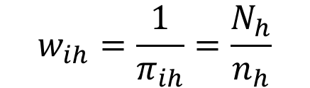
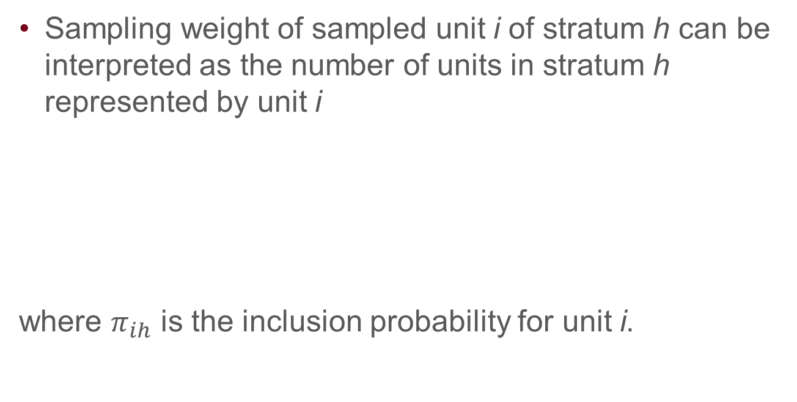
Sampling weight
Sampling weight of sampled unit i of stratum h can be interpreted as the number of units in stratum h represented by unit i
where $π_{ih}$ is the inclusion probability for unit i.
$$w_{ih}=\frac{1}{π_{ih}}=\frac{N_{h}}{n_{h}}$$

Slide 57
Sampling weight
If the population has 1600 men and 400 women, and the stratified sample design specifies sampling 200 men and 200 women, then
each man in the sample has a weight of ____ and each woman has a weight of ____.

Slide 58
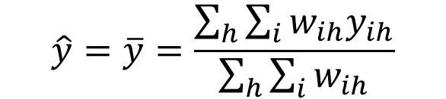

Sampling weight
The population size is estimated by the sum of the weights for the sample:
the population mean is estimated by
$$N=\sum_{h}{\sum_{i}{w_{ih}}}$$
$$\hat{y}=\overline{y}=\frac{\sum_{h}{\sum_{i}{w_{ih}y_{ih}}}}{\sum_{h}{\sum_{i}{w_{ih}}}}$$

Slide 59

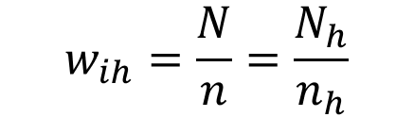
Proportional Allocation
Proportional allocation means the same proportion of units was sampled in each stratum
The number of sampled units in each stratum is proportional to the size of the stratum
The inclusion probability for unit i in stratum h is the same for all strata.
$$w_{ih}=\frac{N}{n}=\frac{N_{h}}{n_{h}}$$
$$π_{i}=π_{ih}=\frac{n}{N}$$

Slide 60
Proportional Allocation
The probability that an individual will be selected to be in the sample, n/N, is the same as in an SRS
With proportional allocation, each unit in the sample represents the same number of units in the population.

Slide 61
Proportional Allocation
If the population has 1600 men and 400 women, and the stratified sample design specifies sampling 400 individuals with proportional allocation, then
The sample will have ____ men and ____ women
The probability of being selected for each individual is _____
The sampling weight for men is _____ and for women is _______

Slide 62
Disproportional allocation
The U.S. Postal Service has conducted surveys asking postal customers about their perceptions of the quality of mail service.
The population of residential postal service customers is stratified by geographic area, and it is desired that the precision be ±3 percentage points, at a 95% confidence level, within each area.
The USPS may choose to sample 1,100 customers in each area.
This is disproportional but provide desired precision.
Notes:
If there were no nonr esponse, such a requirement would lead to sampling at least 1067 households in each stratum, as calculated in Example 2.12. Such an allocation is neither propor tional, as the num ber of residential hous eholds in the popul ation varies a great deal from stratum to stratum, nor optimal in the sense of providing the greatest ef ciency for estimating percentages for the whole population. It does, however, provide the desired precision w ithin each stratum.

Slide 63
Which to use?
If you are taking a stratified sample in order to ensure that the sample reflects the population with respect to the stratification variable and you would like your sample to be a miniature version of the population, you should use proportional allocation.
Disproportional allocations specify oversampling one or more of the strata. It may be needed if you want to guarantee that estimates calculated from individual strata will achieve a specified degree of precision.

Slide 64
Which to use?
A stratified sample with disproportional allocation is representative, in the sense that it can be used to estimate any numerical quantity that could be calculated from the population, but it is not a small-scale replica of the population.
You must use the sampling weights when graphing data and computing estimates; otherwise, your estimates will be biased.

Slide 65

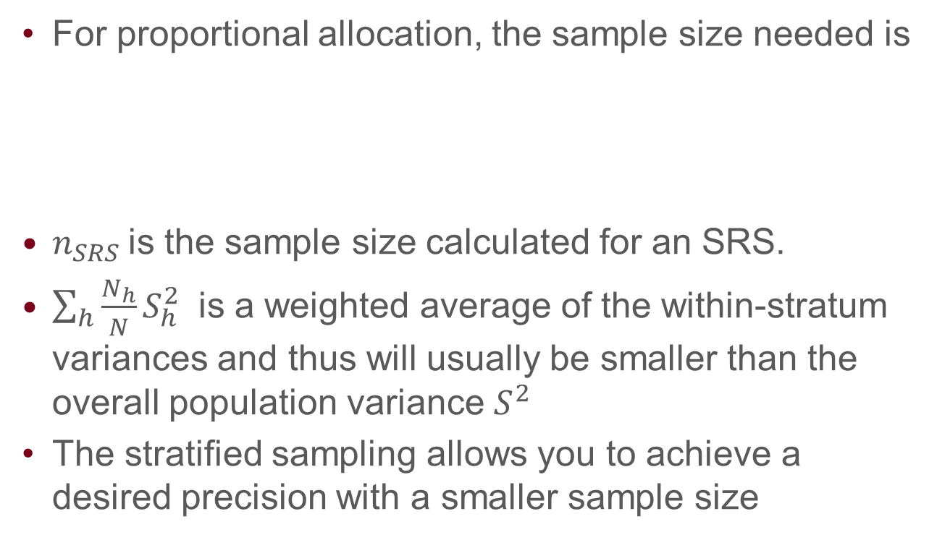
Determining the Total Sample Size
For proportional allocation, the sample size needed is
$n_{SRS}$is the sample size calculated for an SRS.
$\sum_{h}{\frac{N_{h}}{N}S_{h}^{2}}$ is a weighted average of the within-stratum variances and thus will usually be smaller than the overall population variance $S^{2}$
The stratified sampling allows you to achieve a desired precision with a smaller sample size
$$n_{SRS}×\frac{\sum_{h}{\frac{N_{h}}{N}S_{h}^{2}}}{S^{2}}$$

Slide 66
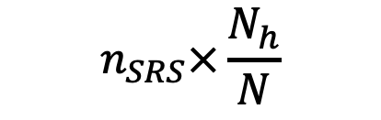
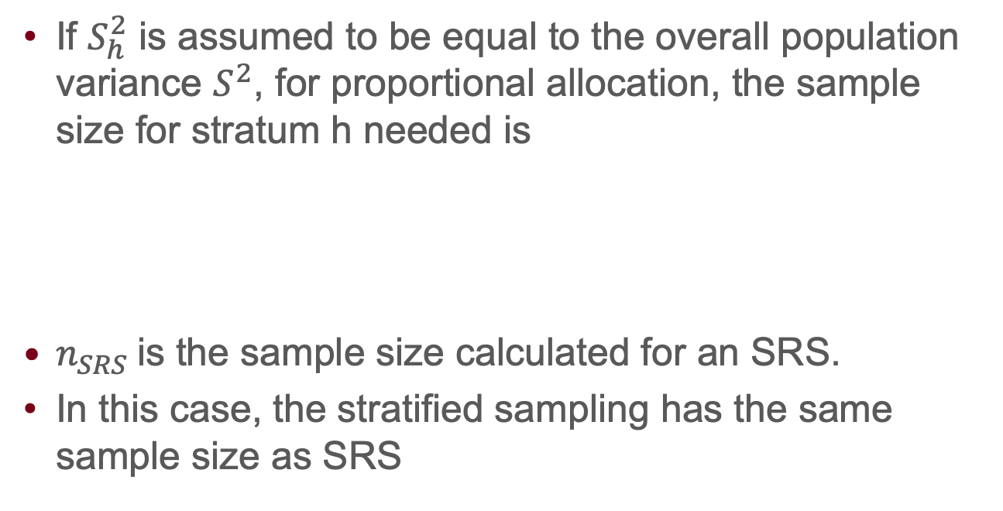
Determining the Total Sample Size
If $S_{h}^{2}$ is assumed to be equal to the overall population variance $S^{2}$, for proportional allocation, the sample size for stratum h needed is
$n_{SRS}$is the sample size calculated for an SRS.
In this case, the stratified sampling has the same sample size as SRS
$$n_{SRS}×\frac{N_{h}}{N}$$

Slide 67
An example
Men make up a small minority of early childhood education (ECE) teachers, with an estimate of 3%.
Now assume that you want to do a survey for ECE teachers in Minnesota to see the proportion of them who are certified.
Suppose there are about 1,000 ECE teachers in Minnesota and you want to use a 95% CI with margin of error 0.06.
If you take an SRS, the same size needs to be _____.
If we do a proportional stratified sample for male and female, the number of male teachers sampled will be _______.

Slide 68
Defining Strata
Stratified sampling with proportional allocation improves (or does not harm) the precision for every variable y measured in the survey.
Stratification is most efficient when the stratum means differ widely
When constructing strata, we want the stratum means for y to be as different as possible.

Slide 69
Defining Strata
If we want to do a survey to know the salary of early education teachers
Ideally, H strata with high salary group, …, low salary group
What variables may be associated with salary?
Experience
Race
Sex
Notes:
The problem with this scheme is that we do not know the salary while designing the survey—if we did, we would not need to do a survey at all!

Slide 70
Oversampling & Undersampling
Tools for dealing with uneven proportions of relevant subgroups in a target population
In our example, there were more public school principals than private school principals

Slide 71
Summary
Stratified sampling has three major design issues: defining the strata, choosing the total sample size, and allocating the observations to the defined strata.
proportional allocation yields the same sampling fraction in each stratum.
Proportional allocation almost always results in smaller variances for estimated means and totals than simple random sampling
Disproportional allocation may be preferred if some strata should have higher sampling fractions than others, for example, if it is desired to have larger sample sizes for strata with minority populations.

Slide 72
Summary
Stratified sampling can guarantee a better proportionate representation of the population than SRS
Stratified sampling often gives more precise (having lower variance) estimates for population means and totals than SRS with the same sample size
To achieve the same precision, stratified sampling requires smaller sample size than SRS (when each stratum has similar observations, a.k.a smaller within group variances)

Slide 73
Cluster Samples
First, what is a cluster?
Naturally occurring group of population elements
Examples:
Households made up of individuals
Schools made up of students
Workers within companies

Slide 74
Cluster Samples
Suppose we want to find out how many bicycles are owned by residents in a community of 10,000 households.
We could take a simple random sample (SRS) of 400 households
we could divide the community into 500 blocks of about 20 households each and sample every household in randomly selected 20 blocks --- cluster sampling

Slide 75
Some terms
The blocks are the primary sampling units (psus), or clusters.
The households are the secondary sampling units (ssus)
Often, the ssus are the elements in the population.

Slide 76
Why use cluster samples?
Constructing a sampling frame list of observation units may be difficult, expensive, or impossible.
The population may be widely distributed geographically or may occur in natural clusters such as households or school s, and it is less expensive to take a sample of clusters rather than an SRS of individuals.
Notes:
It is less expensive to take a sample of clusters rather than an SRS of individuals. If the target popul ation is residents of nursing hom es in the United States, it is much cheaper to sample nursing hom es and interview some or all residents in the selected hom es than to interview an SRS of nursing hom e residents: With an SRS of residents, you might have to travel to a nursing hom e just to interview one resident. I

Slide 77
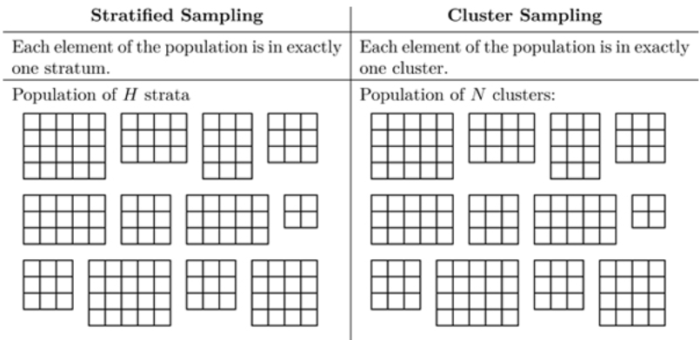
Cluster sampling vs stratified sampling

Slide 78
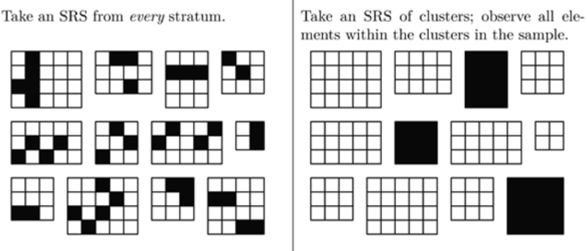
Cluster sampling vs stratified sampling
Notes:
For education surveys, a natural psu is the classroom ; all students in a selected classroom are often included as the ssus since little extra cost is added by handing out a questionna ire to all students in the classroom rather than some

Slide 79
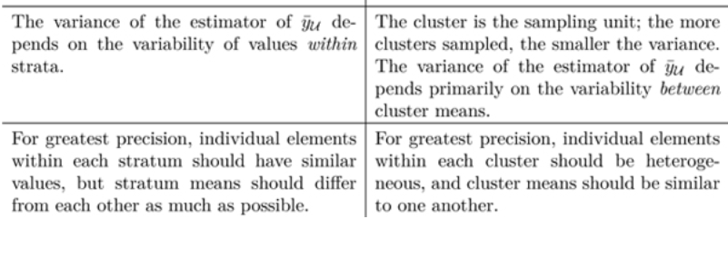
Cluster sampling vs stratified sampling

Slide 80
Cluster sampling vs stratified sampling
Stratification generally increases precision when compared with simple random sampling, cluster sampling generally decreases it.
Members of the same cluster tend to be more similar than elements selected at random
By sampling everyone in the cluster, we partially repeat the same information instead of obtaining new information, and that gives us less precision for estimates of population quantities.
E.g., 100 individuals from a cluster may not provide the same amount of information as 100 independent individuals

Slide 81
When clustering is ignored
Individuals in a cluster are more similar so their responses are not independent
If ignoring clusters and using traditional statistical methods, standard errors would be underestimated
Results appear more accurate than they are
Notes:
One of the biggest mistakes made by researchers using survey data is to analyze a cluster sample as if it were an SRS. Such confusion usually results in the researchers reporting standard errors that are smaller than they shoul d be, and this gives the impression that the statistics from the survey are much more precise than they really are. E

Slide 82
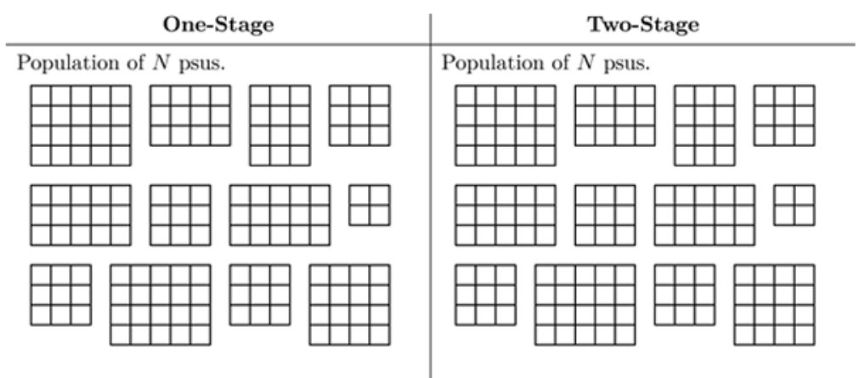
One-stage and two-stage cluster sampling

Slide 83
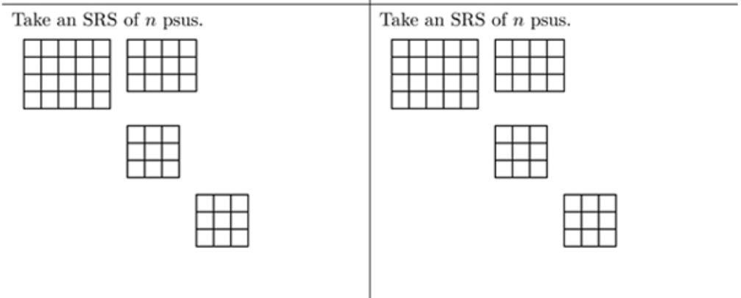
One-stage and two-stage cluster sampling

Slide 84
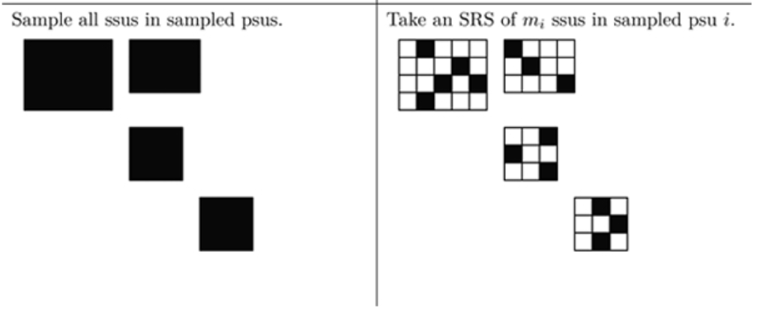
One-stage and two-stage cluster sampling

